Slide 1
Deep-learning Your Brain
Classification of movement execution and imagination using EEG signals
Tim Fischer, Özhan Özen, Joaquin Penalver-Andres
21st May 2019, University of Bern, Advanced Topics in Machine Learning, Prof. Dr. Paolo Favaro

Slide 2
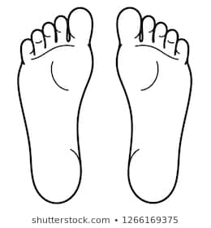
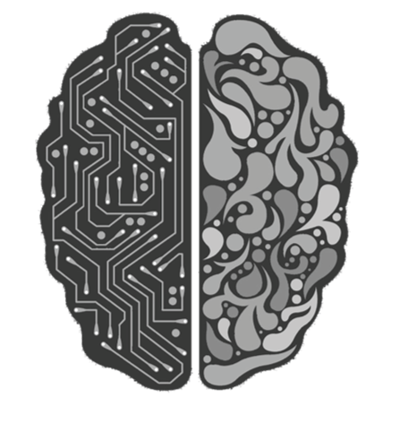
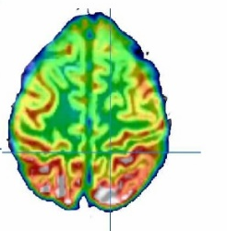
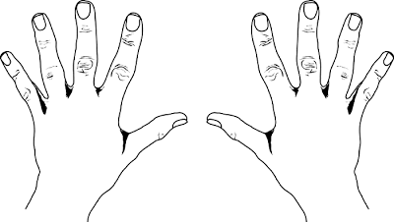
Classification of movement execution and imagination using EEG signals
What do we aim for?
OR
OR

Slide 3
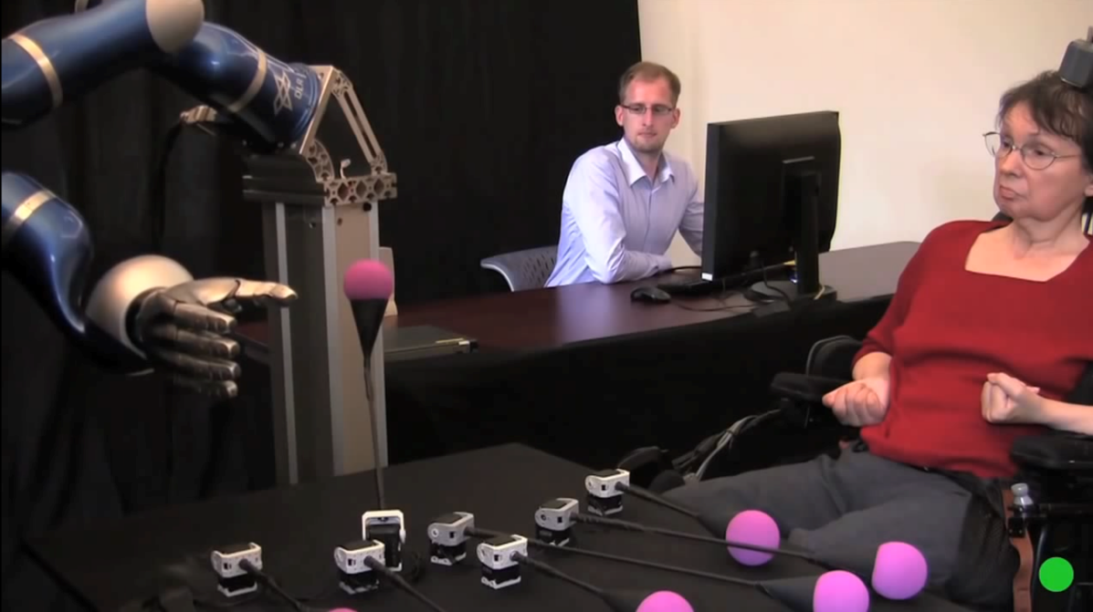
Why to read your mind?
Current and future applications

Slide 4
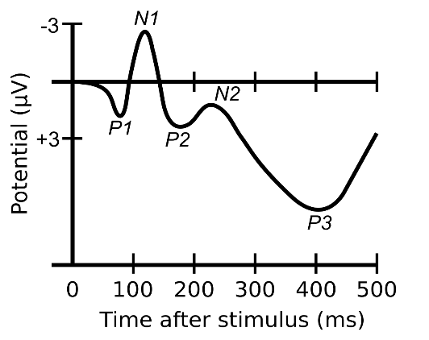
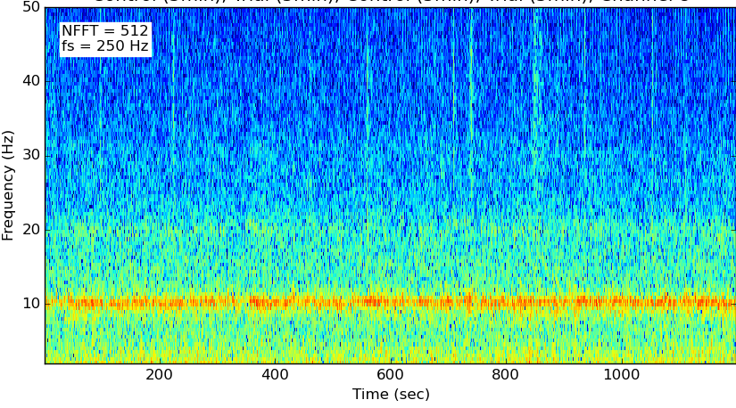
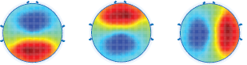
How to understand people’s intention?
EEG Basics
Time Domain
Frequency Domain
Spatial Domain

Slide 5
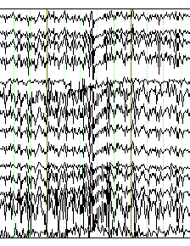
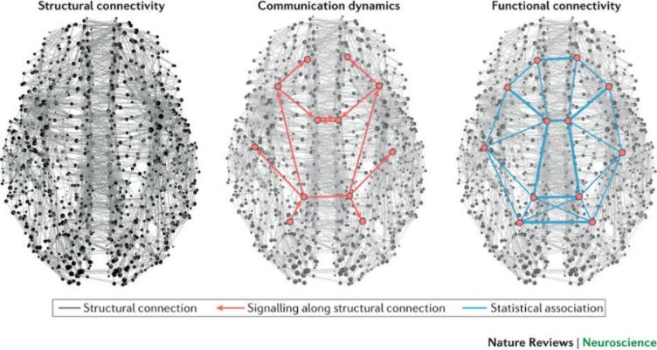
Each person, one world
Challenges in EEG analysis
Images:
Imagenet
>14 mio. Images
EEG:
Physionet BCI 2000
109 subjects, 64 electrodes, 7 different tasks
Artefacts
Complex neural processes
Limited Data

Slide 6
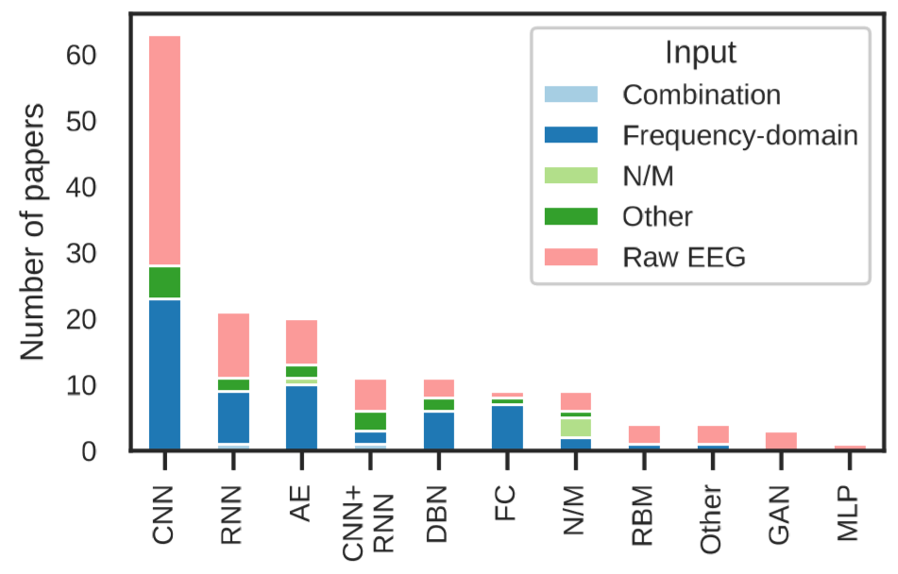
Prior attempts
Classification on EEG Data
Zhang et al. (2018), Advances in Knowledge Discovery and Data Mining
20 subjects, 5 tasks
Sliding window (10 points, 50% overlap)
3D-CNN + LSTM + RL
93% accuracy
Schirrmeister et al. (2017), Hum. Brain Mapp
Compared FBCSP, Deep and Shallow CNN in 5 task clasiffication
Best accuracy over datasets 93% in Shallow CNN
Yannick et. al. (2019), arXiv:1901.05498

Slide 7
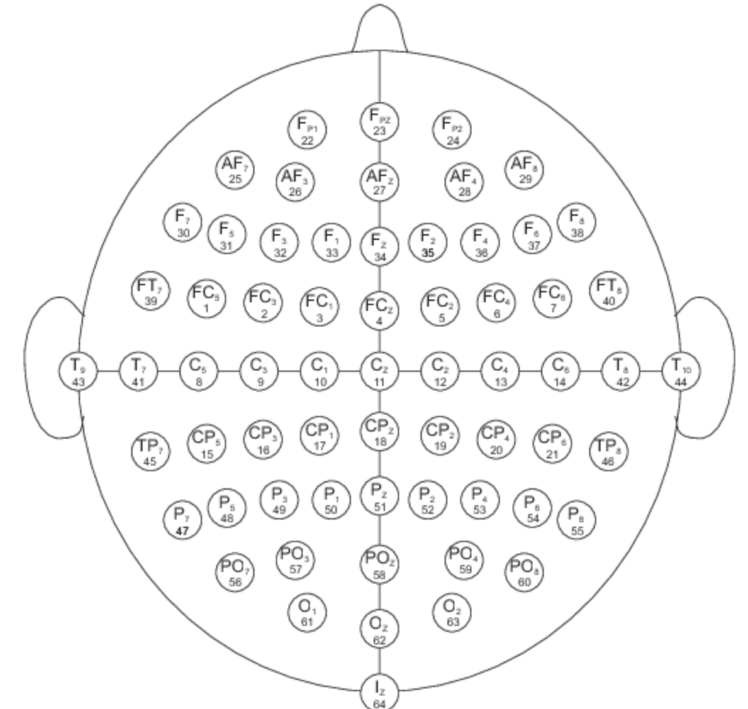
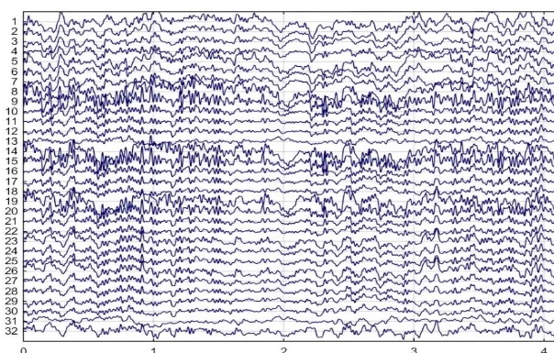

Network structures used
320 (or 10*)
64
11
x32
320 (or 10*)
10
3x3x3
x32
7x3
exRH
exLH
imRH
exLH
exRF
exLF
imRF
imLF
x64
x64
x128
x128
2D CNN
3D CNN (Zhang,2018)
FC Linear
FC Linear
Adam optimizer, Cross Entropy Loss, *with Time Cropping, 20 Subj.

Slide 8
Results
Class | Test accuracy
Exec. Left Hand | 75%
Exec. Right Hand | 78%
Imag. Left Hand | 75%
Imag. Right Hand | 76%
Exec. Both Hand | 80%
Exec. Both Feet | 76%
Imag. Both Hand | 76%
Imag. Both Feet | 77%
Neural Network | Test Accuracy
3D-CNN cropped
3D-CNN | 28.9%
2D-CNN cropped | 73.1%
2D-CNN | 32.2%
77.1%

Slide 9
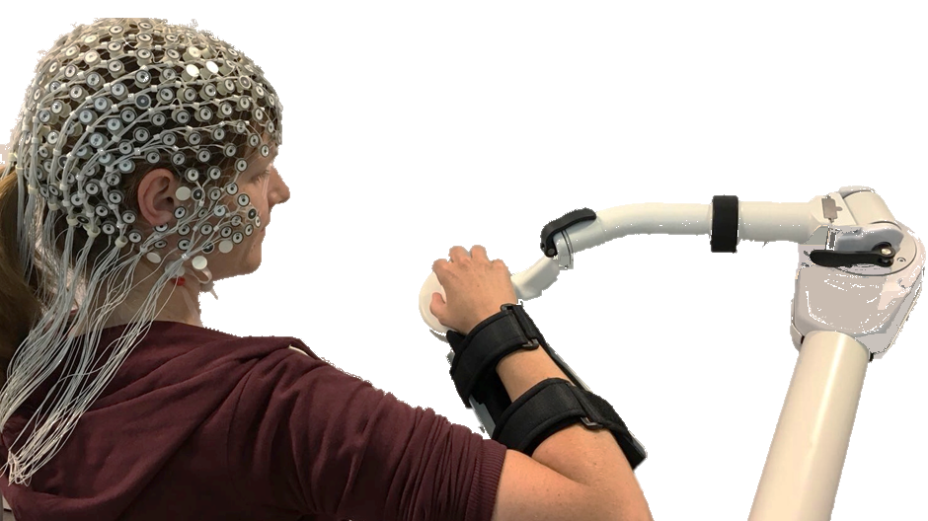
Discussion and Future Works
Time cropping is improving performance. Better local temporal information (high frequency), in exchange of slowly changing global temporal change information.
3D-CNN outperforms 2D-CNN due to exploitation of spatial information.
Future Steps:
Integrate RNN to capture global temporal aspects (Zhang, 2018).
Using transfer learning to exploit big Phisionet dataset for motor learning experiments with robots.

Slide 10
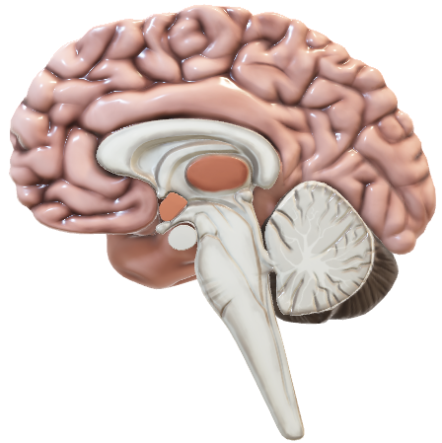
Thanks for your attention!
Questions…?
Take part in our motor learning experiments ;) Write to joaquin.penalverdeandres@artorg.unibe.ch

